Slide 1
Lending Club Case Study
Author
-Asawari bhosale

Slide 2
Problem Statement
You work for a consumer finance company which specializes in lending various types of loans to urban customers. When the company receives a loan application, the company has to make a decision for loan approval based on the applicant’s profile. Two types of risks are associated with the bank’s decision:
If the applicant is likely to repay the loan, then not approving the loan results in a loss of business to the company
If the applicant is not likely to repay the loan, i.e. he/she is likely to default, then approving the loan may lead to a financial loss for the company

Slide 3
Objective:
Identifying the loan applicant trait that are default for paying loans
Identifying the driver behind the default loan data

Slide 4
Data Solving process
Data
Sourcing
Bivariate Analysis
EDA
Data Cleaning
Derived /Segmented Analysis
Univariate Analysis

Slide 5
Data Cleaning
. Removing Null columns and rows . Deleting columns with single unique value . Deleting columns that don't add any value for Analysis . Modifying Null values . Modifying Data type for required analysis . Removing symbols/string to derive relevant data

Slide 6
Analysis
The Main goal of this case study is to analyse the parameters to understand the defaulting criteria.

Slide 7
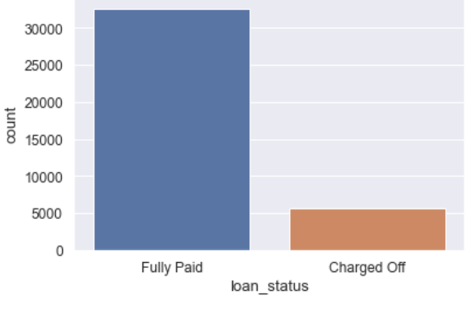
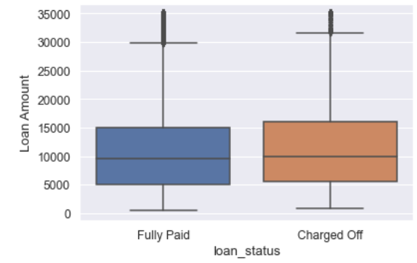
Loan Status Analysis
From the total loan taken around 33,000 have Fully paid the loan and around 5000 have been defaulted.
For loan amount between 5000 to 15000 the mean of fully paid and charged off is same.

Slide 8
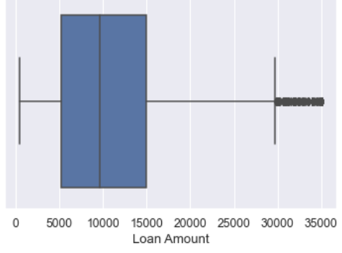
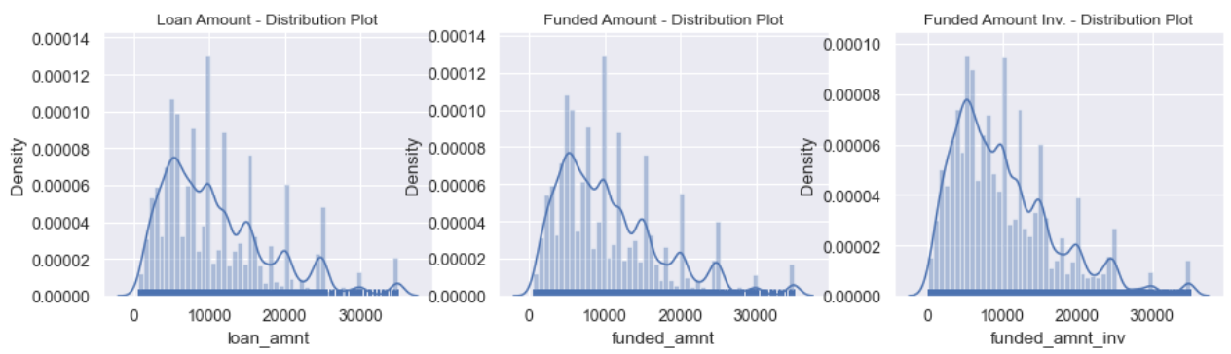
Loan Amount
We have observed 2 outliers, after removing the outliers the mean loan amount is 10000
In distribution plot as well we observe that for loan amount, Funded amount the plot is
leaned/reduced towards the right

Slide 9
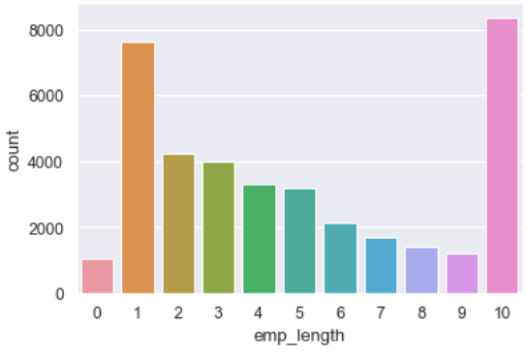
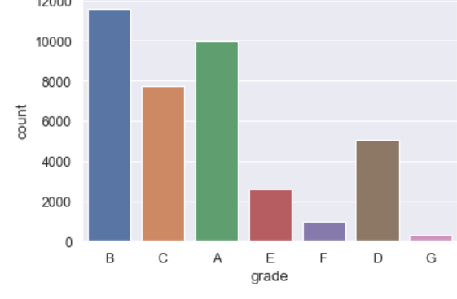
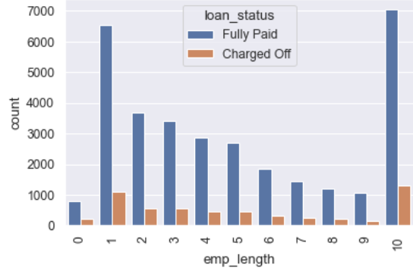
Grade and employee work experience
Majority of loan is applied by employees with 10+ year of work experience. Also employees with 10+ years experience have
maximum defaulted.
Most of the loans have grade A and B. thus stating most of the loan are high grade loan.

Slide 10
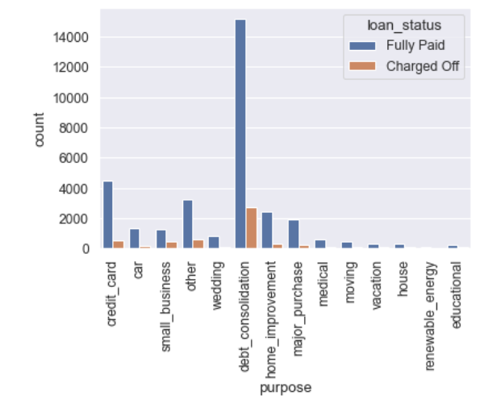
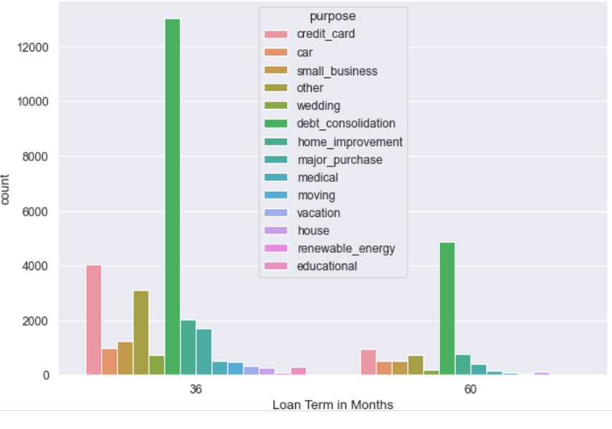
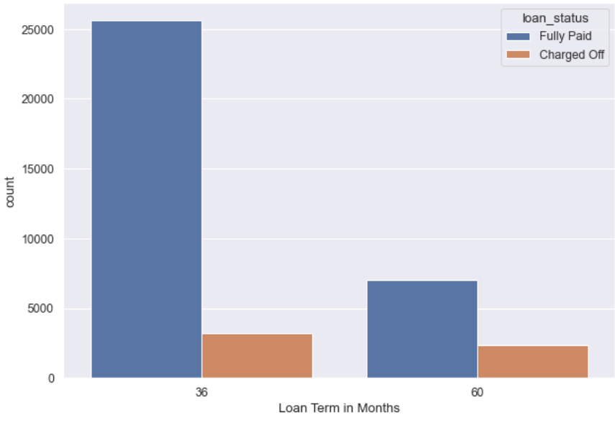
Purpose and Loan Term
Purpose
Maximum fully paid loan was for debt consolidation.
Maximum charged ration was also for debt consolidation
Loan terms
Most of the loans were applied for 36 months tenure as compared to 60 months
Charged off loan for the tenure of 60 months with proportionate to 36 months is high.i.e probability of being default for loan applicant for 60 months is high

Slide 11
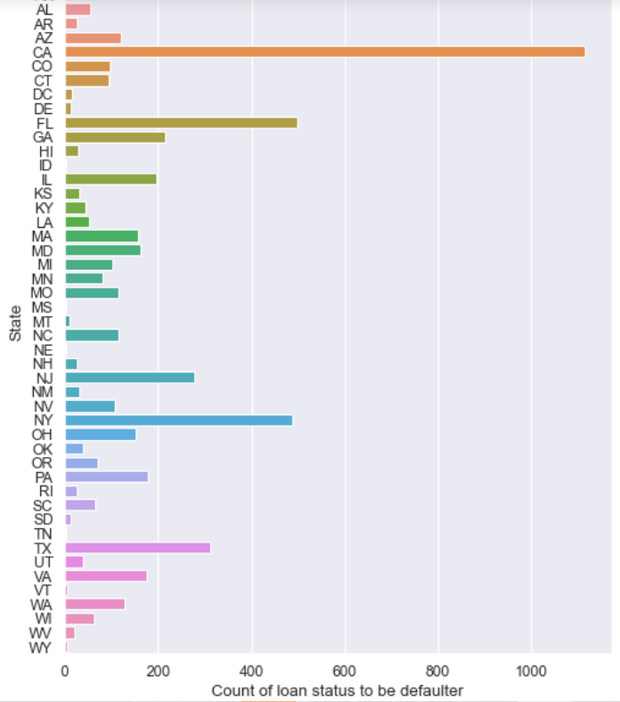
Loan Defaulters as per State
Most of the defaulters are from state CA

Slide 12
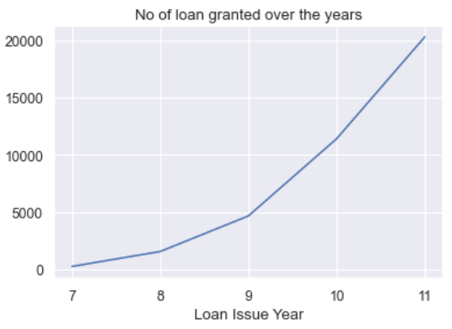
General Analysis
The number of loan applicant is increasing exponentially over the years

Slide 13
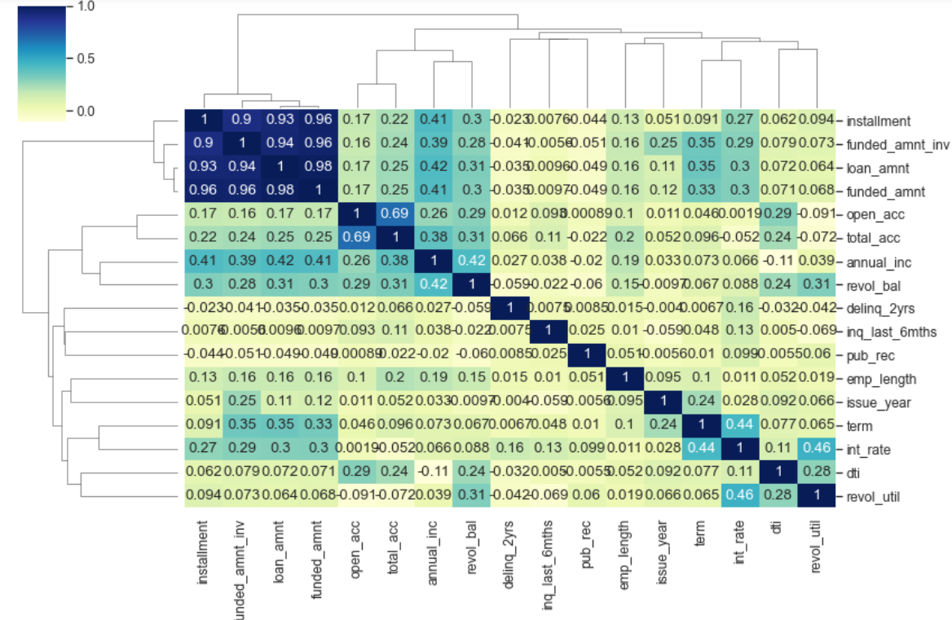
. Funded amount, Loan amount, Investor amount are closely related
. Positive correlation between annual income and employment years.That means income increases with work experience

Slide 14
Conclusion:
Number of Loan Applicant is increasing exponentially over years.
Extra scrutiny must be taken when approving loan for the state CA.
Loan taken for 60 months of Term is proportionately high.
For low grade the chances of Defaulting is high.
Need to be careful When approving loan for 10+ year work experience as defaulting rate is highest.

